Slide 1
Variational Autoencoders VS
Generative Adversarial Networks
Alexander Mennborg
Ismat Halabi
Elliot Härenby Deak

Slide 2
Table of Contents
Introduction
Generative Adversarial Networks
Variational Autoencoders
Comparisons
Future Work

Slide 3
Introduction
Generative models, complex data, hard train
Delimitation: this only considers image generation
Aims to compare performance of both models
Related Work
Goodfellow I. et al. Generative Adversarial Nets
Kingma, D. P. and Welling, M. Auto-Encoding Variational Bayes

Slide 4
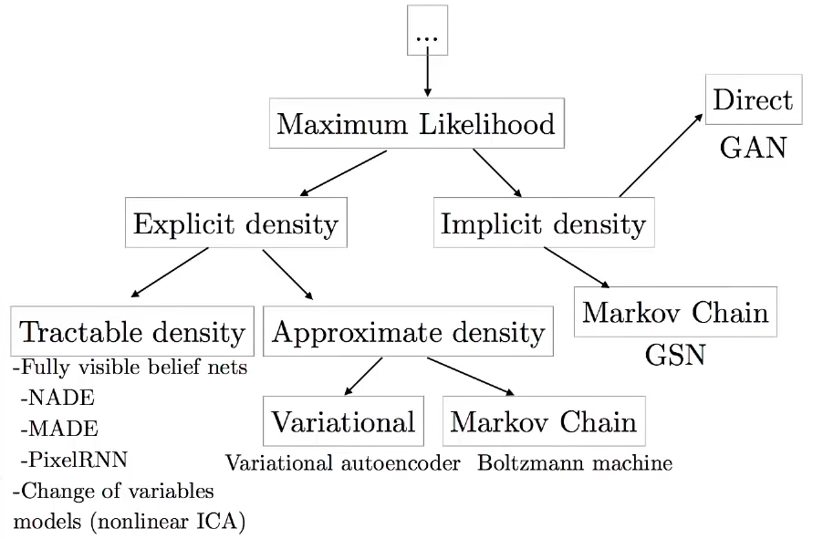
Taxonomy of Generative Models
Image taken from a talk by Ian Goodfellow found here https://www.youtube.com/watch?v=HGYYEUSm-0Q

Slide 5
Generative Adversarial Networks

Slide 6

What are GANs?
Invented by Ian Goodfellow in 2014
Idea: evaluate real/ fake images
Training adversary
Vanilla GANs - MLP
Image credit: Thalles Silva

Slide 7
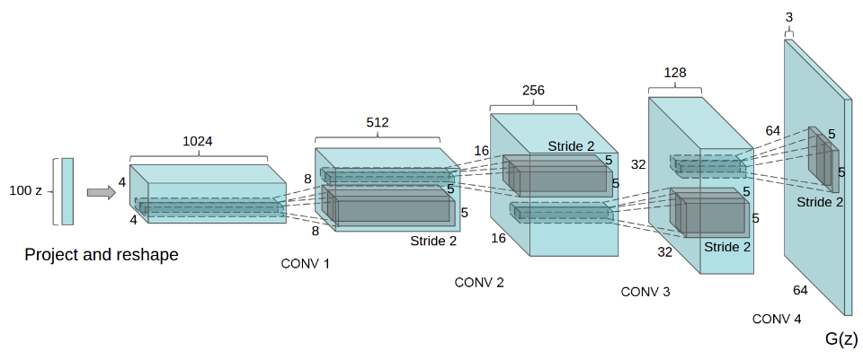
Deep Convolutional GANs (DCGANs)
One specific GAN architecture among many
Generator model inputs latent vector and outputs image
Conv. layers uses transposed convolutions
Discriminator is the opposite except outputs is a number
Radford et al. Unsupervised Representation Learning with Deep Convolutional Generative Adversarial Networks, 2016.

Slide 8


Deep Convolutional GANs (DCGANs) - Tips
Training can be quite unstable
Use batch normalization,
Use strided convolutions instead of pooling layer
Use ReLU (generator) and LeakyReLU (discriminator)
Downscaling
(strided convolution)
2x2 output
⇑
5x5 input
Upscaling
(fractional strided convolution)
5x5 output
⇑
3x3 input (+ padding)
Gifs taken from: https://github.com/vdumoulin/conv_arithmetic

Slide 9
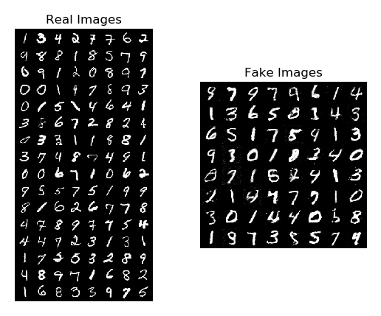
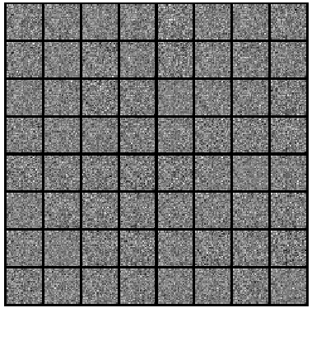
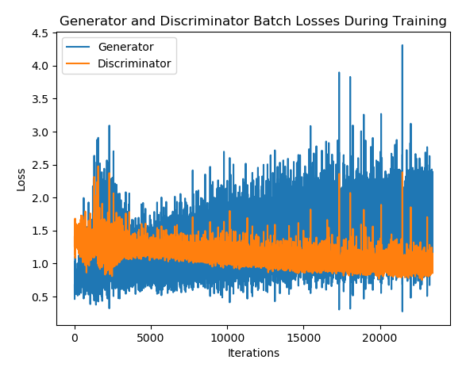
Training Results - MNIST
Real Images
Fake Images
Training Progression
Uses vanilla GANs
Learns overall structure quickly
Some minor denoising happening

Slide 10
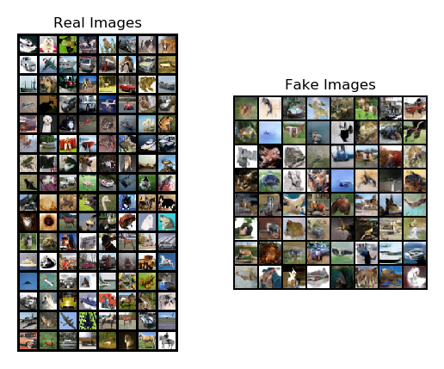
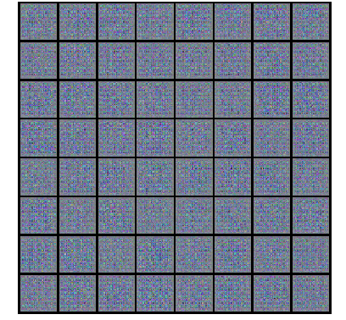
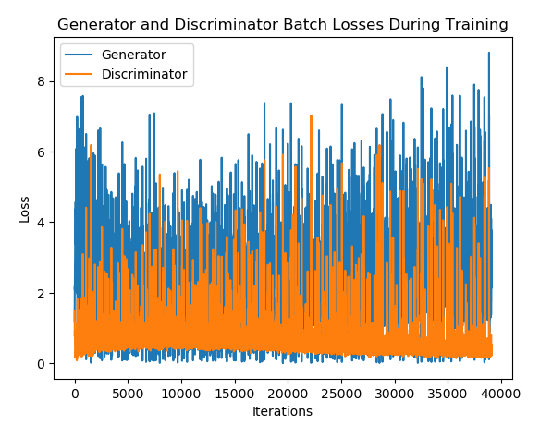
Training Results - CIFAR10
Real Images
Fake Images
Training Progression
Uses DCGANs
Fake images, blurry, CIFAR10 like
Mostly unrecognizable results

Slide 11
Variational Auto-Encoders (VAE) Bayesian

Slide 12
General Idea
Type of unsupervised learning
UL:
No labels, just data
Goal: learn some underlying hidden structure of data
Given observed data points X_n {n=1 to N} distributed according to some (unknown) ground truth distribution p_gt(x), learn a model p that we can sample from, such that p is as similar to p_gt(x) as possible.

Slide 13
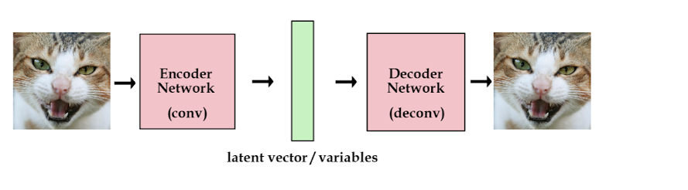
Standard AutoEncoder (AE)
Source: http://kvfrans.com/variational-autoencoders-explained/
Save encoded image
Recover it later
Middle part called bottleneck: dimensionality reduced
Deterministic encoding/decoding, no new images: output ~ input!

Slide 14
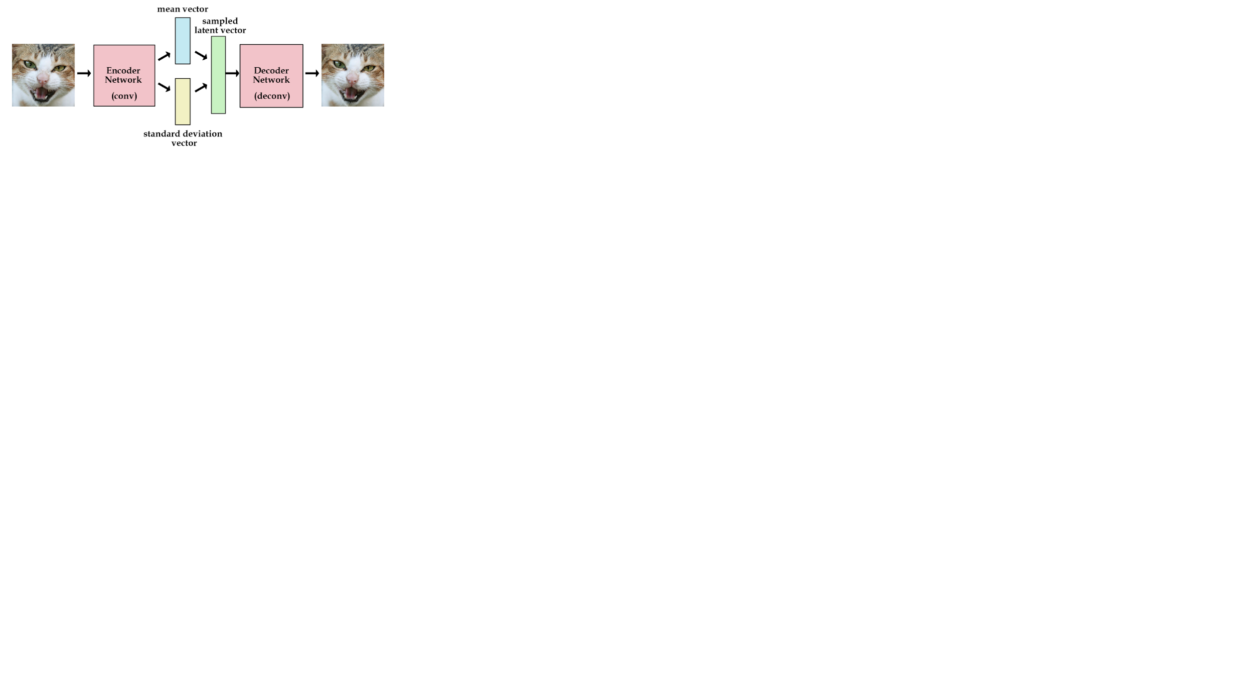
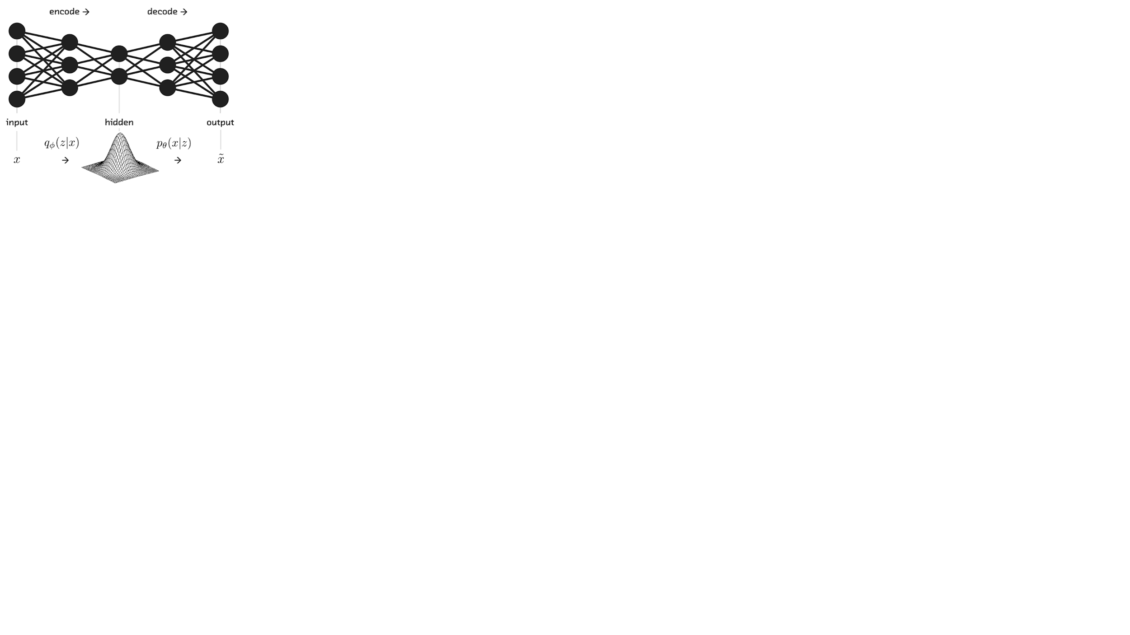
VAE: Constrained Stochastic AE => Generative!
Source: https://towardsdatascience.com/what-the-heck-are-vae-gans-17b86023588a
Source: http://kvfrans.com/variational-autoencoders-explained/
Encoder constraints: generate latent vectors that roughly follows unit gaussian distribution
Sample latent vector from unit gaussian
Parameterization trick: encoder generates vector of means and vector and standard deviations instead of vector of real numbers to optimize KL divergence
Decoder generates new sample from latent space!

Slide 15
Losses
generation loss = mean(square(generated_image – real_image))
Accuracy in reconstruction images
latent_loss = KL_Divergence(latent_variable, unit_gaussian)
How close z matches unit Gaussian
total_loss = generation_loss + latent_loss
Generation loss: same as in standard AE

Slide 16
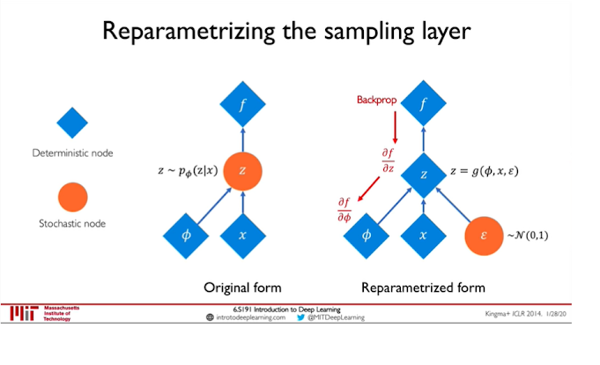
Reparameterization Trick
Source: https://www.youtube.com/watch?v=rZufA635dq4
z = 𝜇 + 𝜎.𝜖, only 𝜇 and 𝜎 trained, 𝜖 purely stochastic, all Gaussian unit Allows for end-to-end training

Slide 17
ELBO: Evidence Lower Bound
Originally, p(x) = ∫p(z).p(x|z)dz intractable (decoder)
Similarly, p(z|x) = p(x|z)p(z) / p(x) also intractable (Bayes’ theorem, encoder)
ELBO(x) = Expected(z|x) [log p(x,z) – log q(z|x)]
q(z|x): stochastic encoder, p(z|x): true posterior
Objective:
maximize ELBO (data likelihood, tractable)
Minimize KL divergence (distance) of stochastic encoder from true posterior

Slide 18
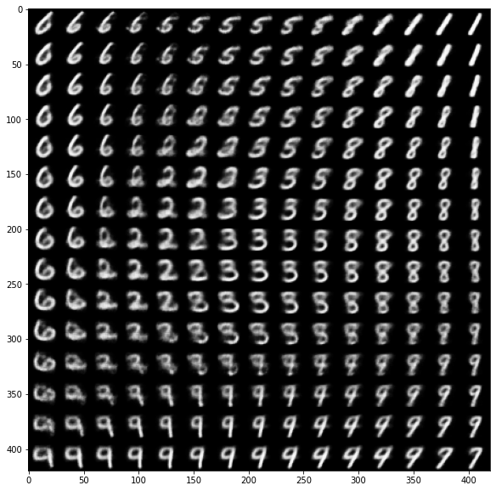
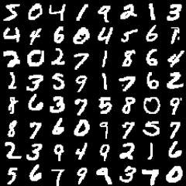
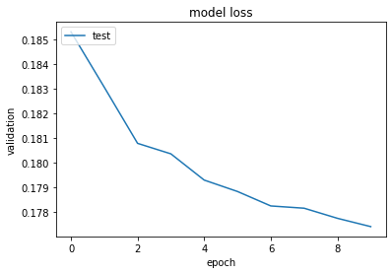
Training Results
Generated images
2D variations of z decoded
CNN / transposed CNN used
Fake images
Real images

Slide 19
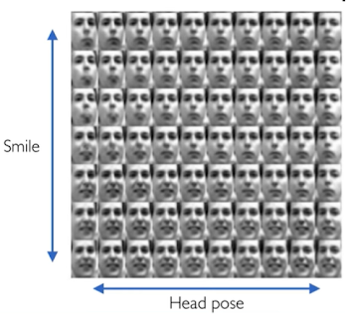
Exploring Latent Space
Slowly increase/decrease one latent variable leaving others unchanged along each dimension => “continuous" output
Each dimension encodes different latent feature
Wanted: uncorrelated latent variables
Source: https://www.youtube.com/watch?v=rZufA635dq4

Slide 20
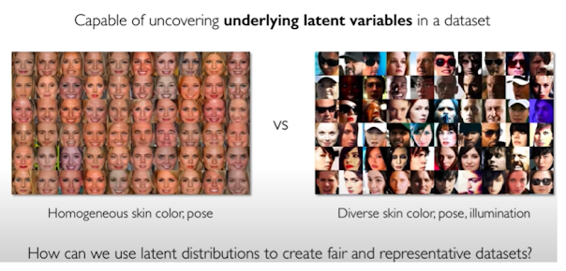
Application: Debiasing, RL, SL
Source: https://www.youtube.com/watch?v=rZufA635dq4

Slide 21
Experience Gained with VAE
Used ready code in github
Difficult to adapt:
Compact code but minor changes may break the functioning of the model
Understand the intuition but not the maths

Slide 22
Comparison and Differences

Slide 23
Main differences between generators
GAN
Based on two networks (discriminative/generative)
Discriminator is not useful after training
Learns to generate directly from gaussian data
VAE
Based on one network
Encoder not used after training, but could be
Learns to compress data to gaussian distribution and decompress it back to image, gaussian noise yields new data

Slide 24
Comparison by results
VAE fake images
GAN fake images
Real images

Slide 25
Comparison of generators - “pros” and “cons”
GAN
Convincing data
Sharp
Somewhat noisy
Difficult to navigate in latent space
May suffer from Mode Collapse
Only real/fake basis
Difficult to evaluate - no one to rule the all
VAE
Convincing data
Easy to navigate in latent space
Fuzzy-looking

Slide 26
Supervised? Unsupervised? Semi/self-supervised?
Most probably unsupervised, according to most litterature
GANs - Unsupervised with supervised loss
VAEs do not have labels - Unsupervised according to MIT and Stanford
Input is used as reference to the output

Slide 27
Why not combine them?
Future work

Slide 28
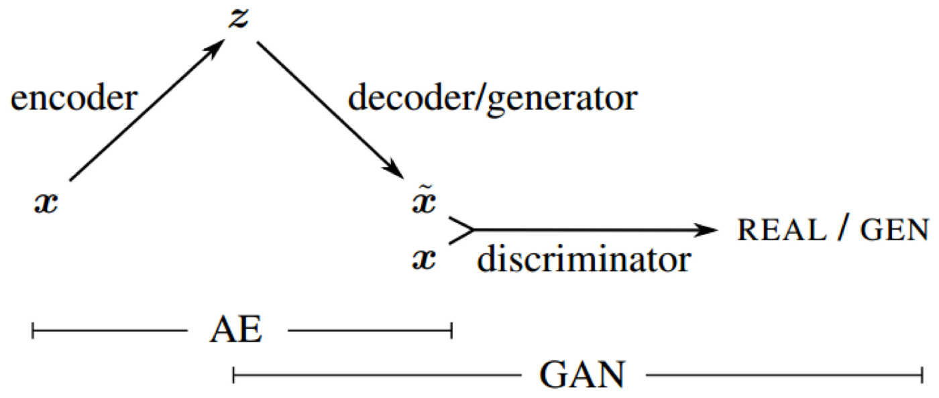
VAE-GAN
Combination of VAE and GAN
Basically merge decoder and generator
Use discriminator during training
From “Autoencoding beyond pixels using a learned similarity metric” A. Larsen

Slide 29
References
Goodfellow I. et al. Generative Adversarial Nets, 2014
Radford A., Metz L., Chintala S. Unsupervised Representation Learning with Deep Convolutional Generative Adversarial Networks, 2016.
Kingma, D. P. and Welling, M. Auto-encoding Variational Bayes. Proceedings of the 2nd International Conference on Learning Representations (ICLR), Banff, Canada, 2014
A. Larsen Autoencoding beyond pixels using a learned similarity metric, 2016

